Slide 1
GLOWZONE
Under the Guidance of
Mrs.M.Raju, M.Sc IT.,(Ph.D).,
Assistant Professor

Slide 2
AGENDA
Abstract
Module Description
Software/Hardware Specifications
Existing System and Proposed Systems
Data Flow Diagram
ER Diagram
Screenshots
Conclusion

Slide 3
ABSTRACT
The objective of developing the project entitled “GLOWZONE” is aimed at computerizing the services provided, cost of the services provided, appointments booked and invoice details.
The main goal of this project is to increase the processing speed and ensures reliability of data.
The system is intended to maintain the records through a computer that facilitates easy data retrieval and avoids information loss and helps to track and maintain old record which helps in a complete analysis of the system.

Slide 4
MODULES
Admin Module
Admin can sign in and see the appointments booked, invoice details and can add customers.
Customer Module
The customer can see the services provided, cost of the services provided and can book the appointments.

Slide 5
SYSTEM SPECIFICATION
HARDWARE SPECIFICATION
System : Intel dual core
Ram : 2GB
Hard disk : 256GB
SOFTWARE SPECIFICATION
Operating System : Windows 7
Front-end : HTML, CSS, JS, PHP
Back-end : SQL Server

Slide 6
EXISTING SYSTEM
PROPOSED SYSTEM
In the existing system, the customer need to go directly to book their appointment. it makes difficulty and tediousness. This process makes inconvenience to the customers. This process is consumes man power.
In the proposed system we have developed a website which helps the customers and labours by making their work easy. The users can register in this website and they can get their required services at their convenient time. Glow zone is available at customers doorsteps by visiting their home too. It also reduces the man power and time.

Slide 7
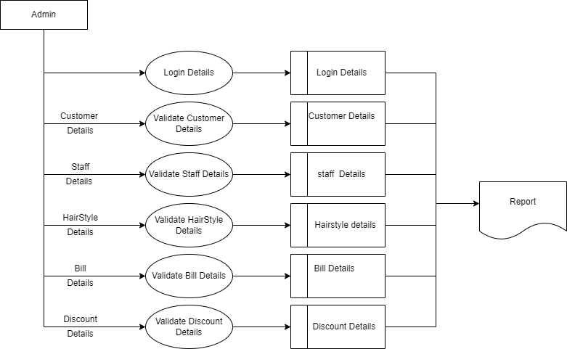
DATA FLOW DIAGRAM

Slide 8
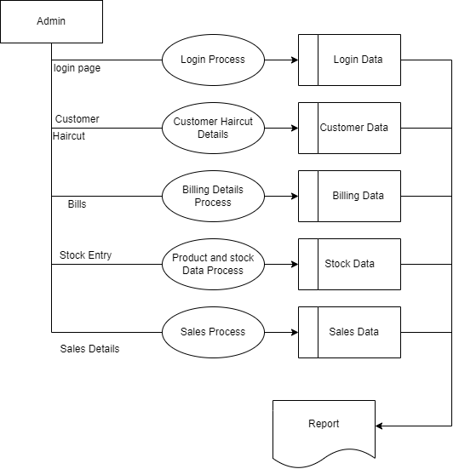

Slide 9
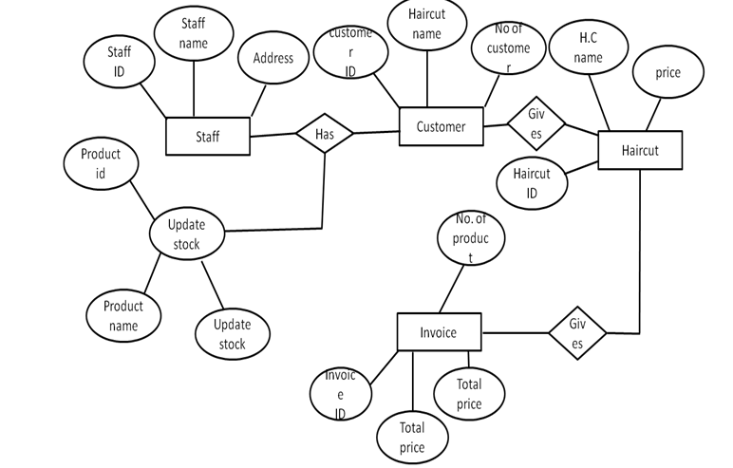
ENTITY RELATIONSHIP DIAGRAM

Slide 10

SCREEN SHOTS

Slide 11


Slide 12
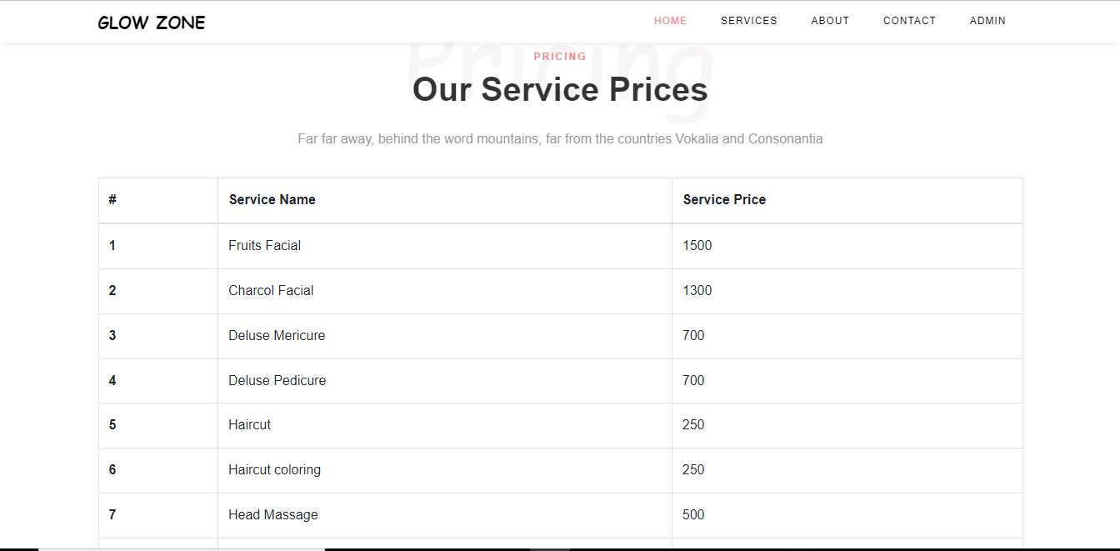

Slide 13
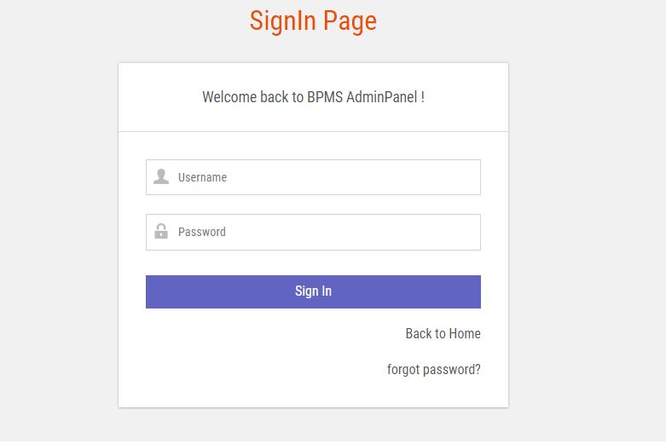

Slide 14
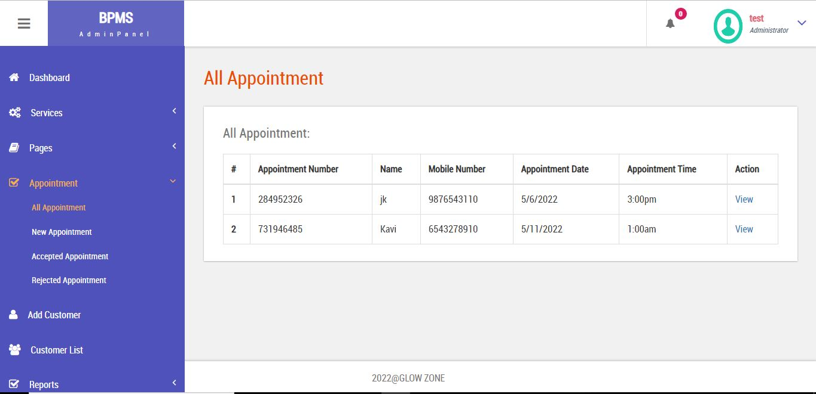

Slide 15
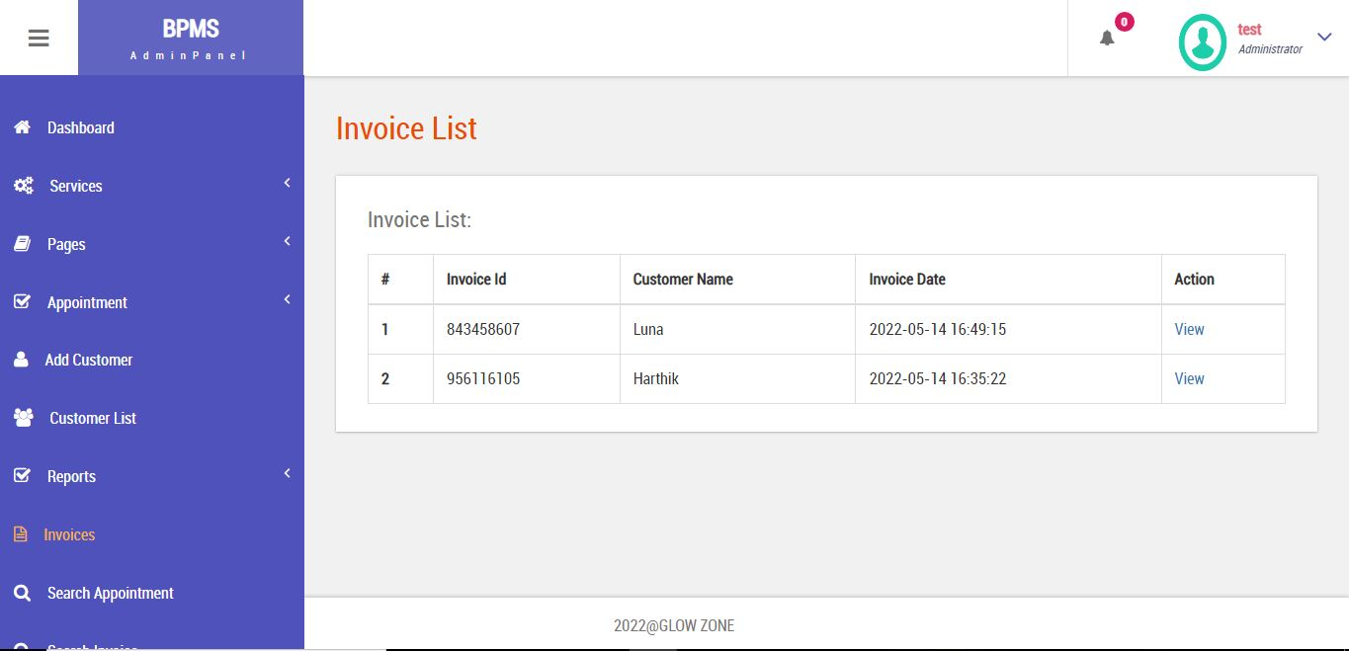

Slide 16
CONCLUSION
The “GLOWZONE” is a online website which has been developed to satisfy all proposed requirements.
The system is highly scalable and user friendly.
This system minimizes the problem arising in the existing manual system and it eliminates the human errors to zero level.
The software executes successfully by fulfilling the objectives of the project.

Slide 17
THANK YOU

